Slide 1

SQL Injection
Dr. Muhammad Umar Aftab

Slide 2

Outline
Introduction
What is SQL
SQL Injection against Select Statement
Modify Database Using SQL Injection
Similarity With Other Code Injection
Countermeasure

Slide 3
What is SQL
Brief Description about SQL

Slide 4
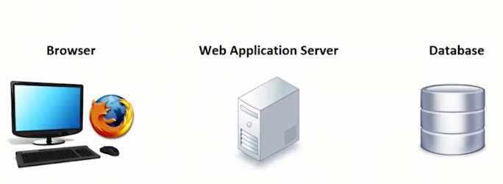
Web Application Architecture

Slide 5
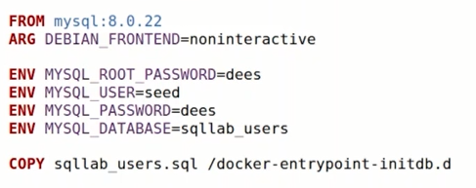
Database Docker’s File

Slide 6
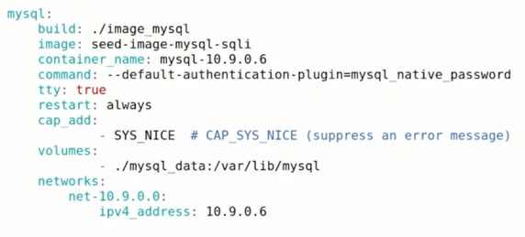
The docker-compose.yml file

Slide 7
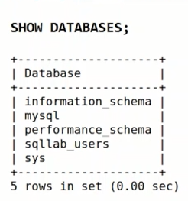
Show all the databases

Slide 8
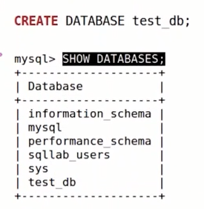
Create Database

Slide 9
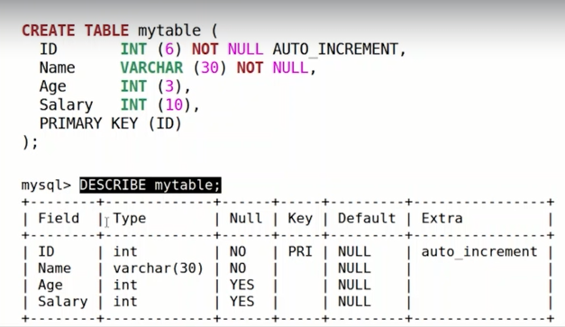
Create Table

Slide 10
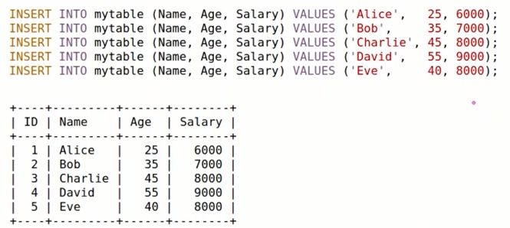
Insert Records

Slide 11
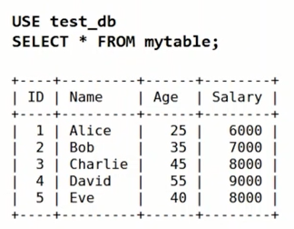
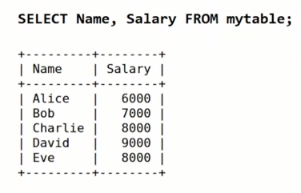
Select Statement

Slide 12
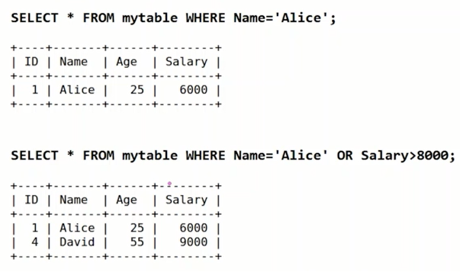
Conditions: WHERE

Slide 13
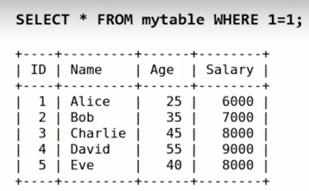
Special Condition

Slide 14
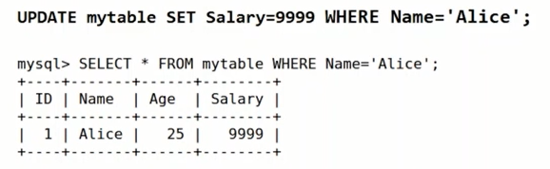
Update Statement

Slide 15

Comments in SQL Statement

Slide 16
SQL Injection against Select Statement

Slide 17
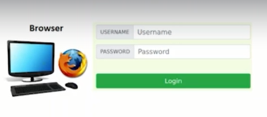

How Web Application Interact With Database (1/2)

Slide 18
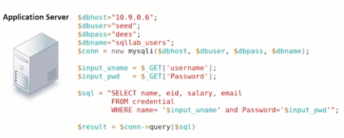
How Web Application Interact With Database (2/2)

Slide 19
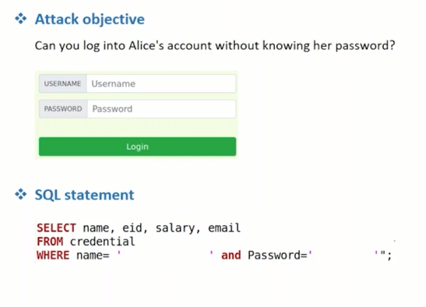
Login Without Password: First Case (1/3)

Slide 20
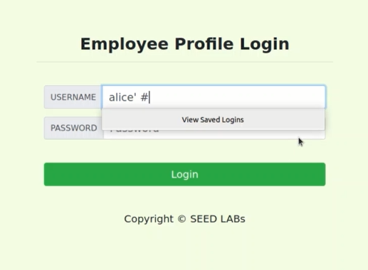
Login Without Password: First Case (2/3)

Slide 21
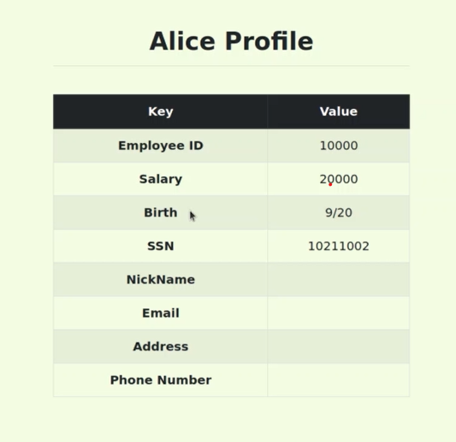
Login Without Password: First Case (3/3)

Slide 22
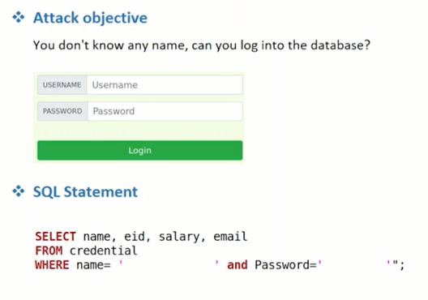
Login Without Password: 2nd Case (1/3)

Slide 23
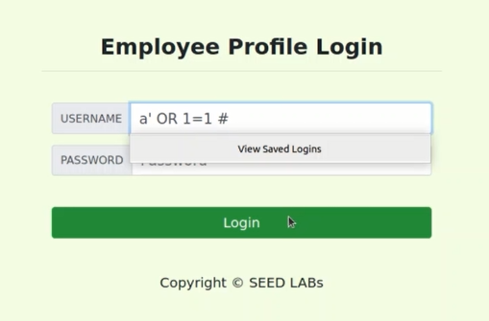
Login Without Password: 2nd Case (2/3)

Slide 24
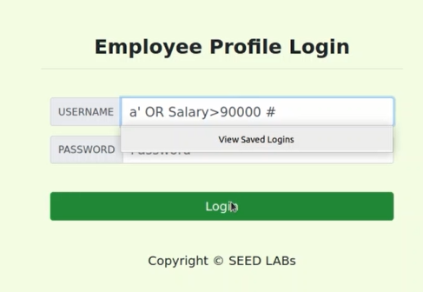
Login Without Password: 2nd Case (3/3)

Slide 25
Modify Database Using SQL Injection

Slide 26
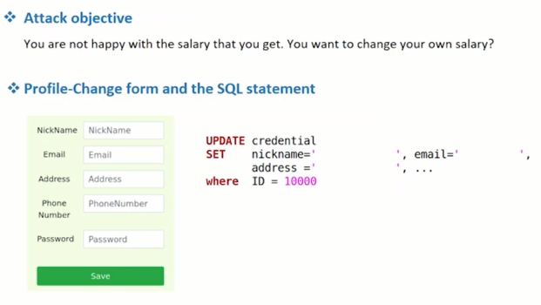
Change Your Own Salary (1/4)

Slide 27
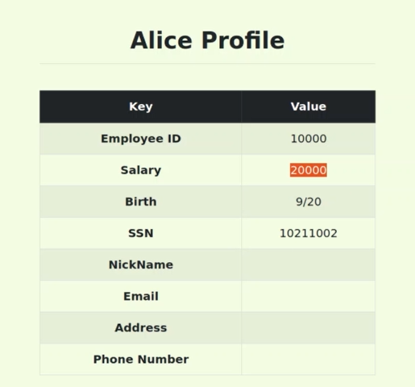
Change Your Own Salary (2/4)

Slide 28
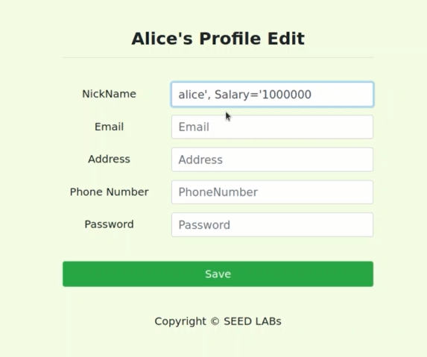
Change Your Own Salary (3/4)

Slide 29
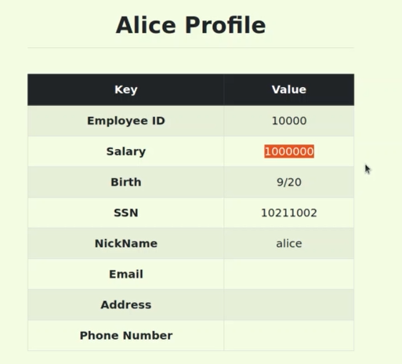
Change Your Own Salary (4/4)

Slide 30
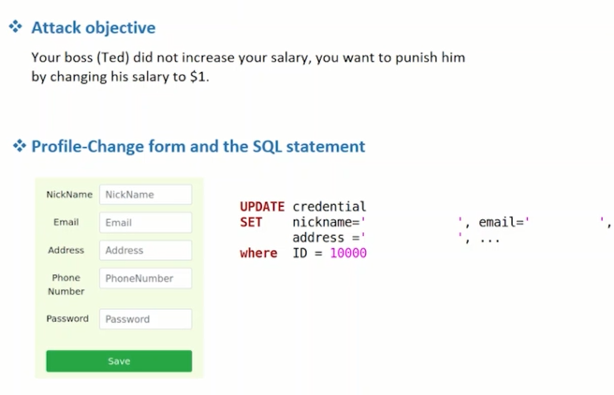
Change Someone’s Salary (1/4)

Slide 31
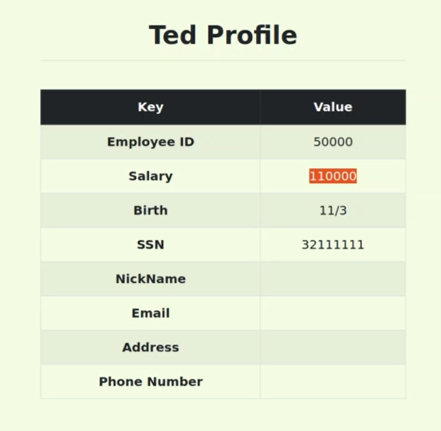
Change Someone’s Salary (2/4)

Slide 32
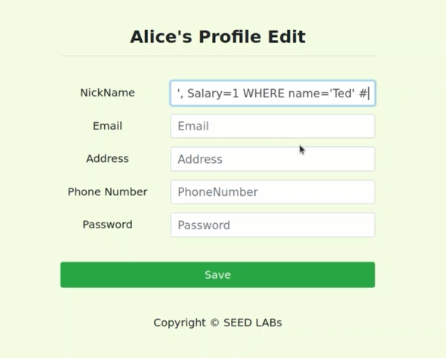
Change Someone’s Salary (3/4)

Slide 33
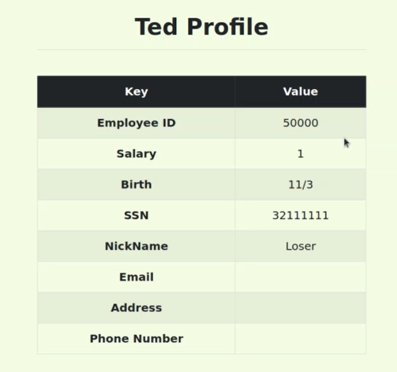
Change Someone’s Salary (4/4)

Slide 34
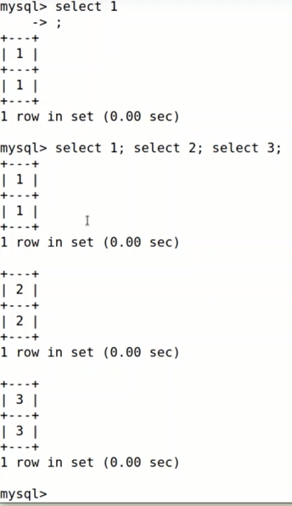
Run Multiple SQL Statement

Slide 35
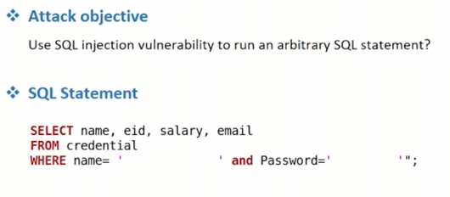
Run Arbitrary SQL Statement

Slide 36
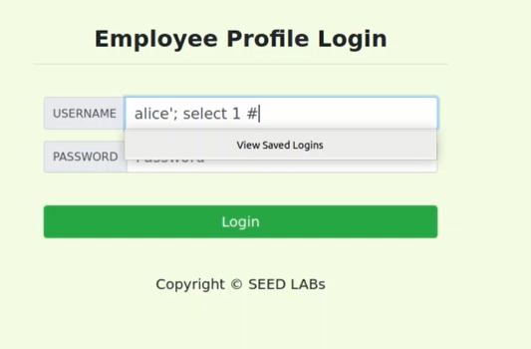
Run Arbitrary SQL Statement

Slide 37
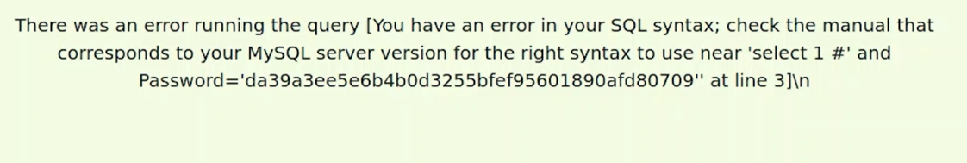
Countermeasure of Database
The database will block multiple SQL statement. Actually, this is countermeasure that is written in PHP code. The PHP use API to invoke database. The API support to one single SQL statement.

Slide 38
Similarity With Other Code Injection

Slide 39
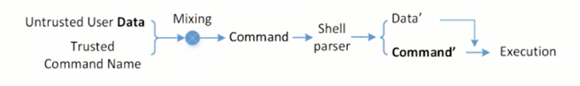
System Injection

Slide 40
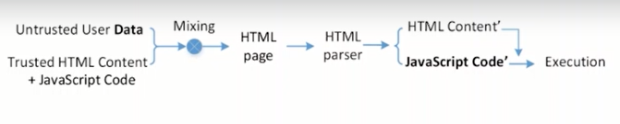
Javascript Injection (Cross-Site Scripting)

Slide 41
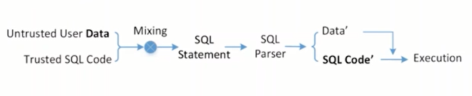
SQL Injection

Slide 42
Countermeasure

Slide 43
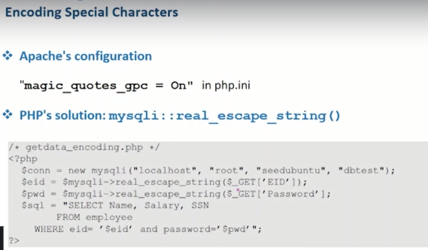
Turning Code into Data

Slide 44
Separate Code and Data
Turning code into data or apply filter is not reliable solution. Because, attacker can easily bypass both solutions.
Another solution is that separate code and data and pass both through separate channel to avoid code inject. Mostly SQL engines provide this solution for performance called prepared statements.

Slide 45

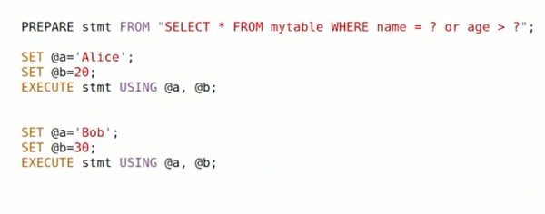
Prepared Statement

Slide 46
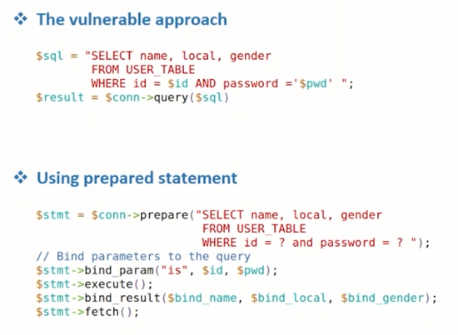
Prepared Statement Program

Slide 47


